Slide 1
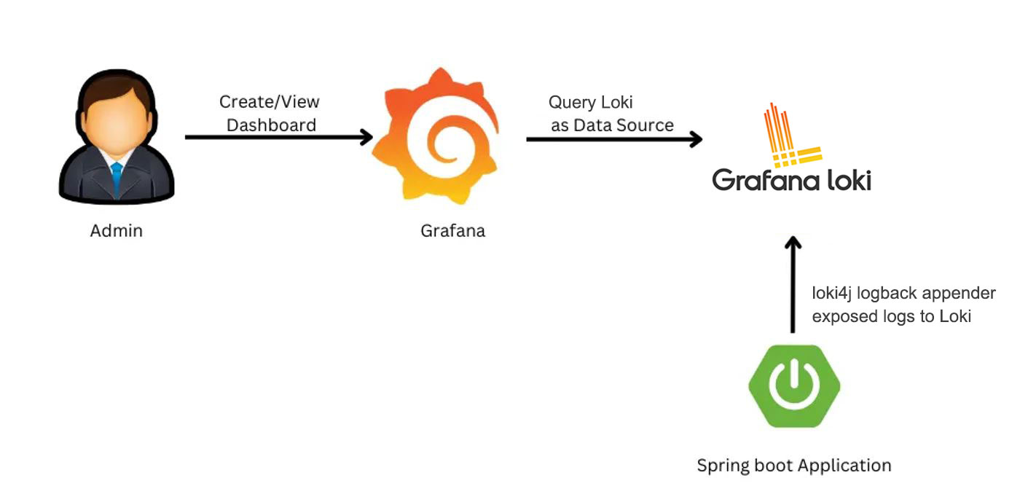
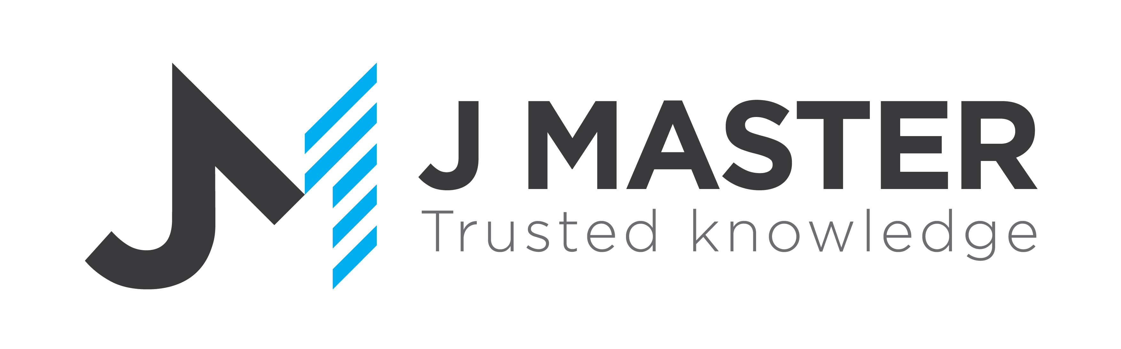
Spring Boot Logs with Loki
www.jmaster.io/course/microservices-with-spring-cloud

Slide 2

Loki is a horizontally scalable, highly available, multi-tenant log aggregation system designed to store and query logs from all your apps and infrastructure.
very cost effective and easy to operate
It does not index the contents of the logs, but rather a set of labels for each log stream

Slide 3
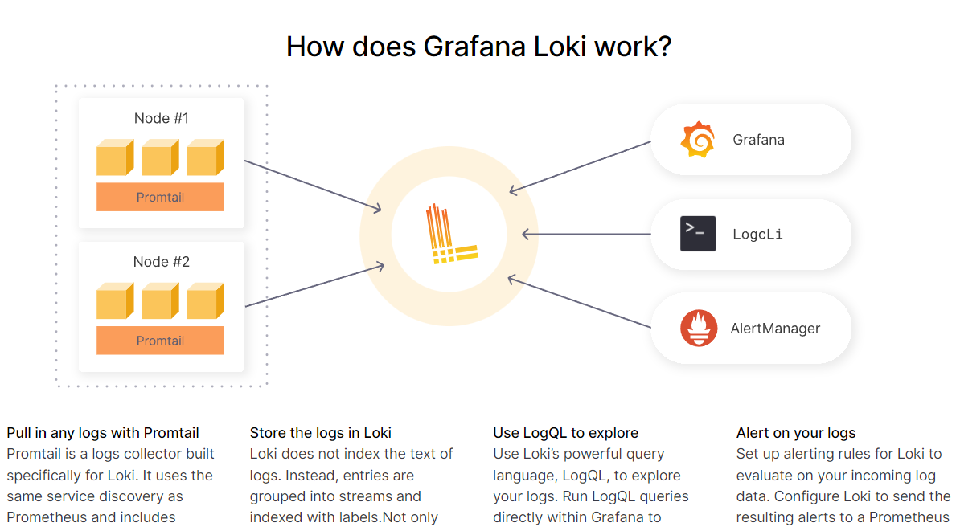
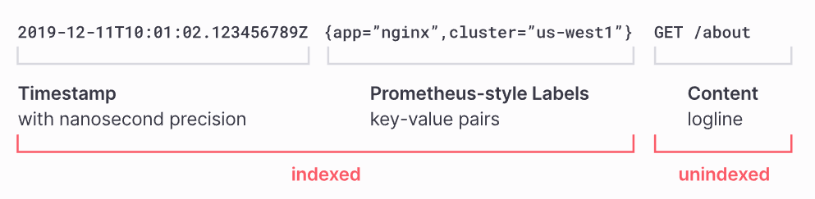

Slide 5
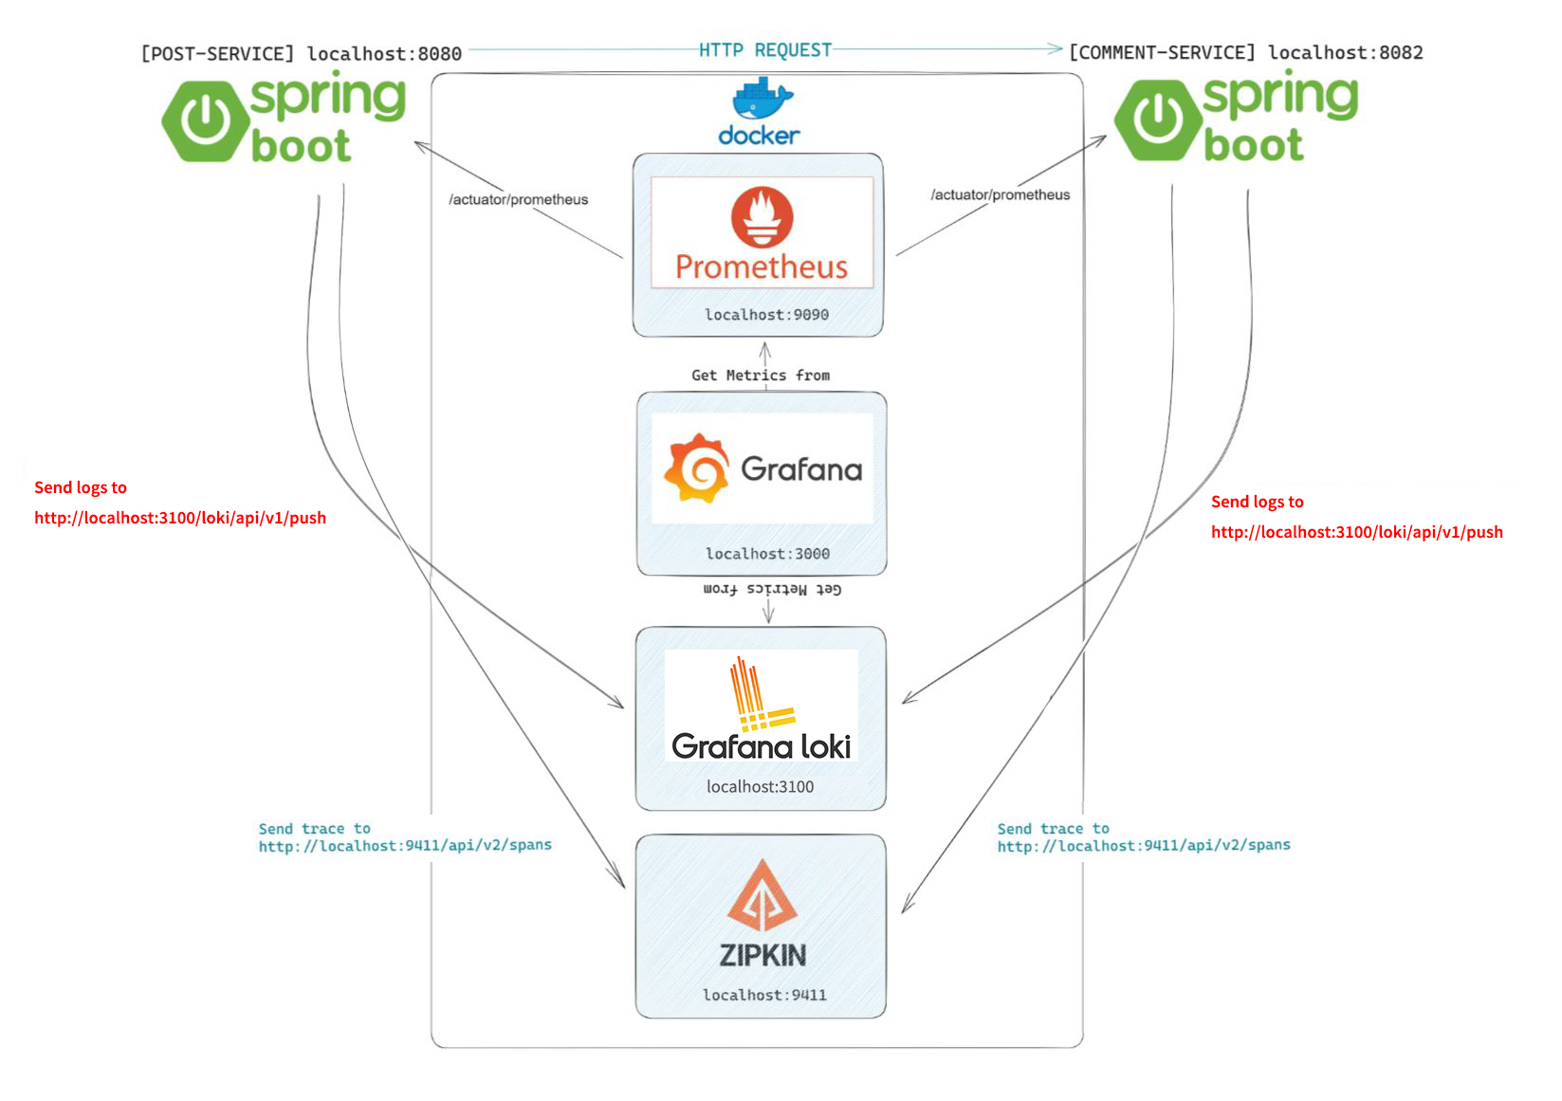
Observability System

Slide 6
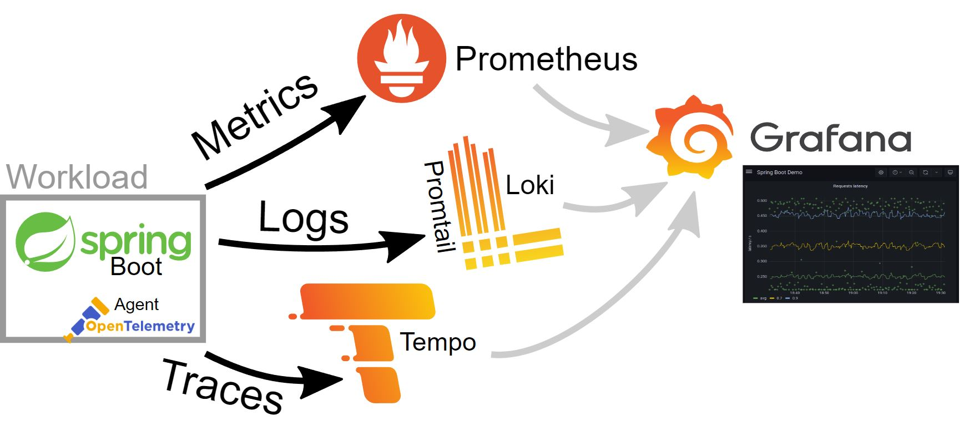
Grafana System

